Slide 1
Compiler Design

Slide 2
Compilers and Interpreters
“Compilation”
Translation of a program written in a source language into a semantically equivalent program written in a target language
Input
Source
Program
Compiler
Target
Program
Error messages
Output

Slide 3
Compilers and Interpreters (cont’d)
“Interpretation”
Performing the operations implied by the source program
Source
Program
Interpreter
Output
Input
Error messages

Slide 4
The Analysis-Synthesis Model of Compilation
There are two parts to compilation:
Analysis determines the operations implied by the source program which are recorded in a tree structure
Synthesis takes the tree structure and translates the operations therein into the target program

Slide 5
Other Tools that Use the Analysis-Synthesis Model
Editors (syntax highlighting)
Pretty printers (e.g. doxygen)
Static checkers (e.g. lint and splint)
Interpreters
Text formatters (e.g. TeX and LaTeX)
Silicon compilers (e.g. VHDL)
Query interpreters/compilers (Databases)

Slide 6
Preprocessors, Compilers, Assemblers, and Linkers
Skeletal Source Program
Preprocessor
Source Program
Compiler
Target Assembly Program
Assembler
Relocatable Object Code
Linker
Libraries and
Relocatable Object Files
Absolute Machine Code

Slide 7
The Phases of a Compiler
Phase | Output | Sample
Programmer | Source string | A=B+C;
Scanner (performs lexical analysis) | Token string | ‘A’, ‘=’, ‘B’, ‘+’, ‘C’, ‘;’ And symbol table for identifiers
Parser (performs syntax analysis based on the grammar of the programming language) | Parse tree or abstract syntax tree | ; | = / \ A + / \ B C
Semantic analyzer (type checking, etc) | Parse tree or abstract syntax tree
Intermediate code generator | Three-address code, quads, or RTL | int2fp B t1 + t1 C t2 := t2 A
Optimizer | Three-address code, quads, or RTL | int2fp B t1 + t1 #2.3 A
Code generator | Assembly code | MOVF #2.3,r1 ADDF2 r1,r2 MOVF r2,A
Peephole optimizer | Assembly code | ADDF2 #2.3,r2 MOVF r2,A

Slide 8
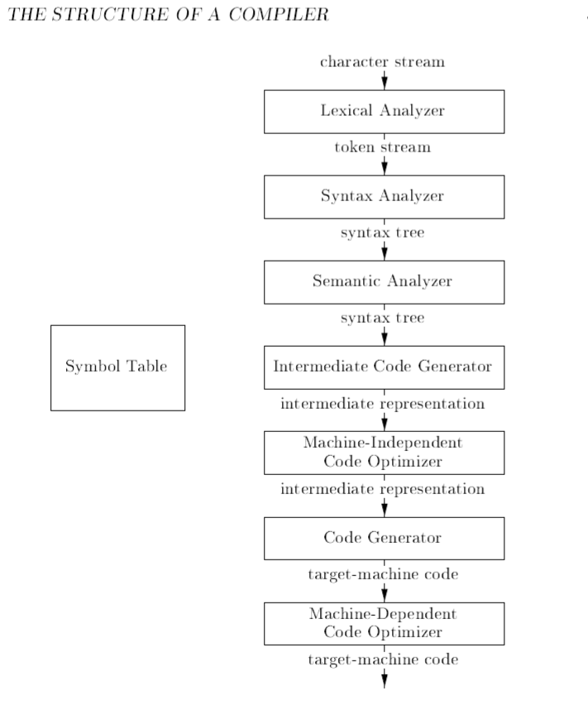

Slide 9
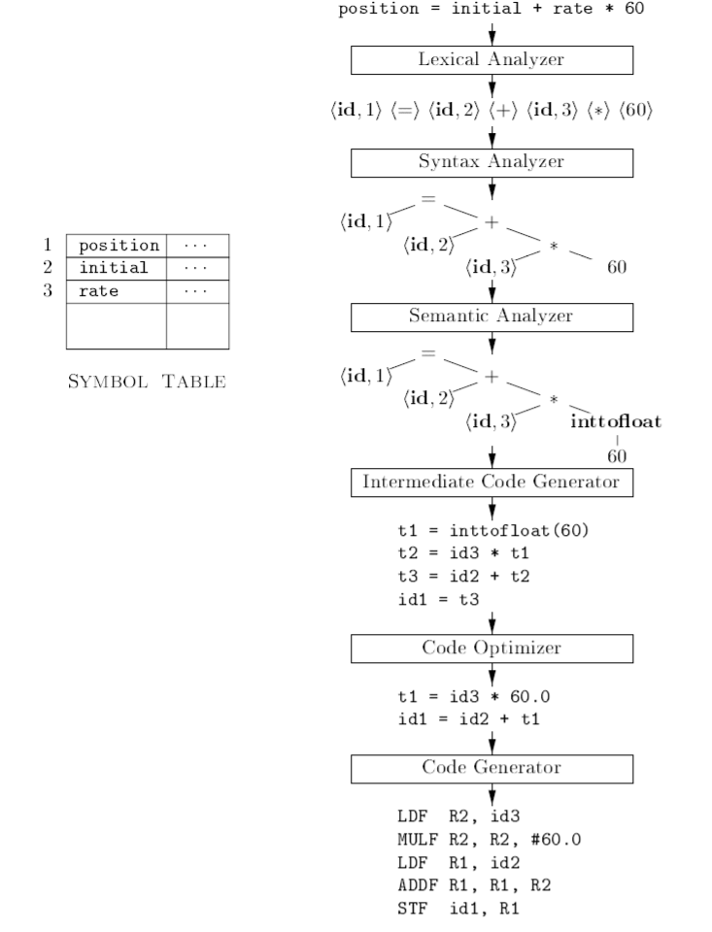

Slide 10
PASCAL Code:
If (x > =y) x = 100 else y = 200

Slide 11
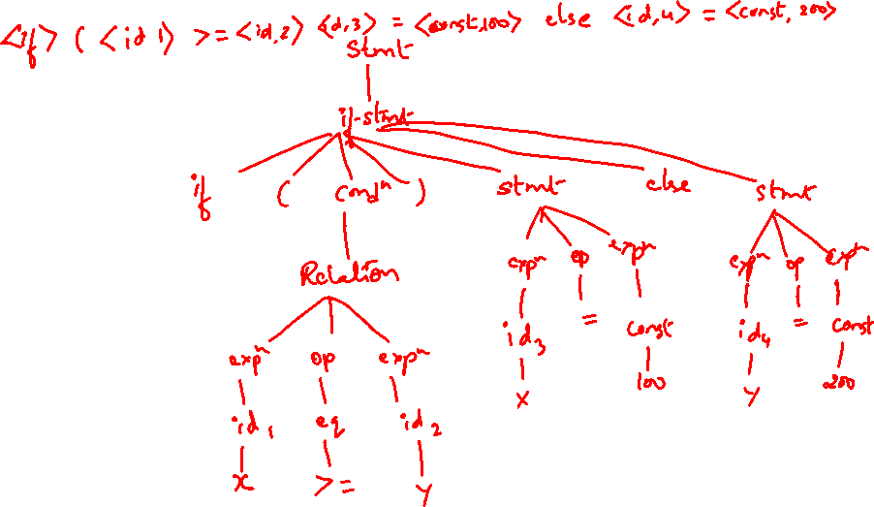
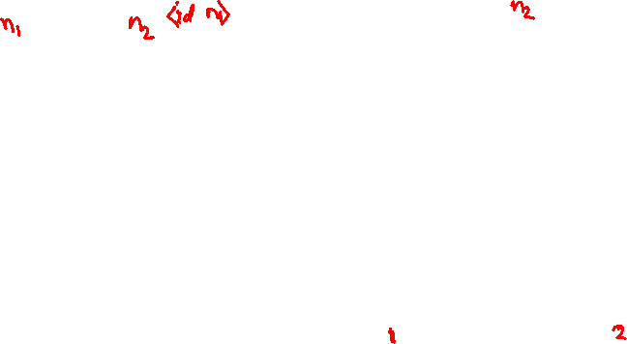
PASCAL Code:
If (x > =y) x = 100 else y = 200

Slide 12
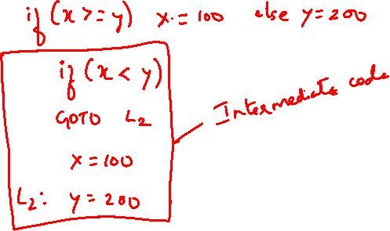

Slide 13
FORTRAN Code:
If (5 EQ MAX) GOTO 100

Slide 14
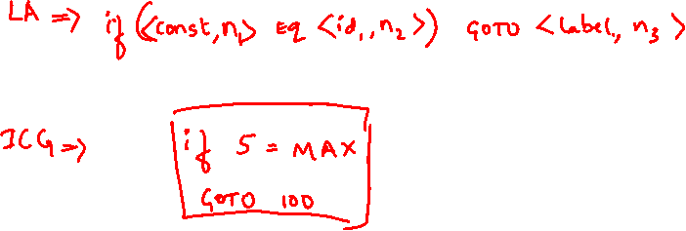
FORTRAN Code:
If (5 EQ MAX) GOTO 100

Slide 15
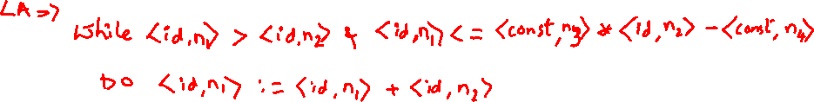
C Code:
While A > B & A< = 2 * B - 5 Do
A : = A + B

Slide 16
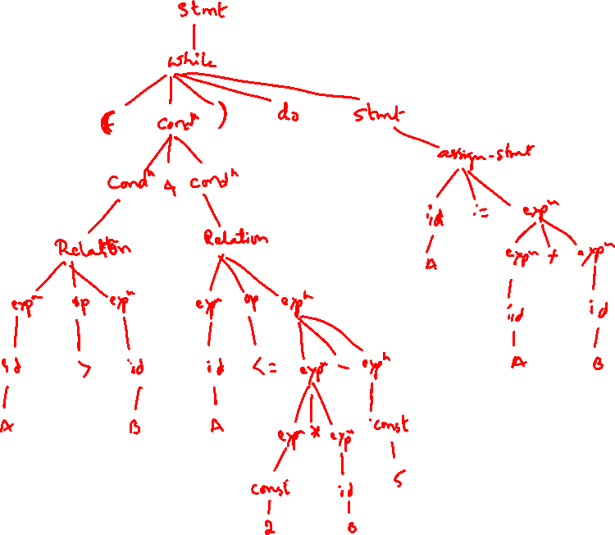

Slide 17
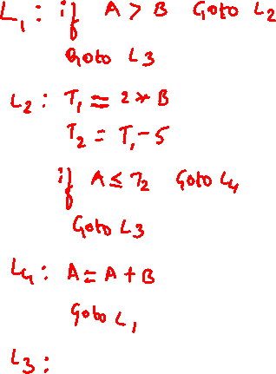

Slide 18
The Grouping of Phases
Compiler front and back ends:
Analysis (machine independent front end)
Synthesis (machine dependent back end)
Passes
A collection of phases may be repeated only once (single pass) or multiple times (multi pass)
Single pass: usually requires everything to be defined before being used in source program
Multi pass: compiler may have to keep entire program representation in memory

Slide 19
Single pass compiler | Multi pass compiler
It scans the entire source code only once | It scans the source code several times
Execution time of the code is less | Execution time of the code is more
Debugging of translated code is difficult | Debugging of translated code is easy
Memory requirements is more to design single pass compiler | Memory requirements is less to design multi pass compiler
The generated code is less efficient | The generated code is more efficient

Slide 20
Single pass compiler | Multi pass compiler
Going back to the previously read source program is not allowed | Going back to the previously read source program is allowed
It is also called as Narrow Compiler | It is also called as Wide Compiler
Pascal and C use single pass compiler | Java require a multi pass compiler.

Slide 21
Logical structure of a pass
Input source program
PASS: A Pass is one complete scan of a program which includes reading an i/p source program and converting the source program into computer or machine understandable form
Compiler
Machine Understandable Code

Slide 22
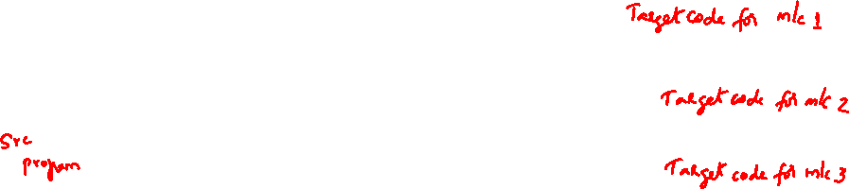
Phase :
A compiler is divided into no.of parts or segments or sections and each section is known as a phase.
The phases are combined together into 2 groups.
Front End– The phases which are language dependent.
Back End– The phases which are machine dependent
For a single Front End we can attach a different Back End to compile a language on machine.
Back End1
Back End2
Front End
Back End3

Slide 23
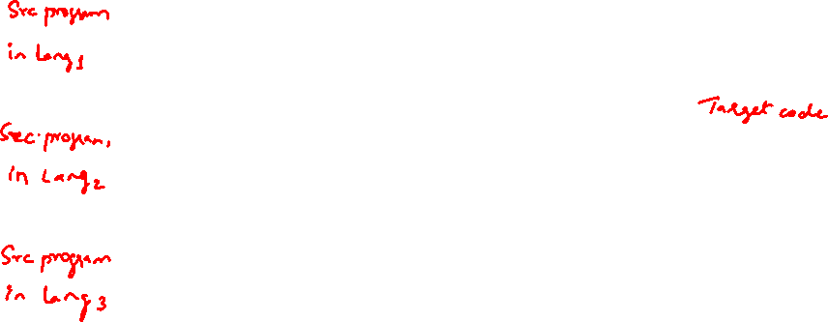
2. To compile different languages on the same machine take a Back End and attach different Front Ends as necessary.
Front End1
Front End2
Back End
Front End3

Slide 24
Compiler-Construction Tools
Software development tools are available to implement one or more compiler phases
Scanner generators
Parser generators
Syntax-directed translation engines
Automatic code generators
Data-flow engines

Slide 25
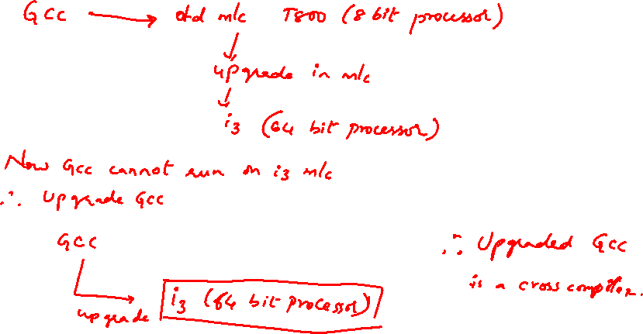
Cross Compiler(Retargetting)

Slide 26
Cross Compiler(Retargetting)
Creating more &more compilers for the same source language but for different machines is called Retargetting
Retargetable compiler is also called Cross Compiler
In cross compiler modification is easy to generate code for different architecture. Hence code generated is less efficient.

Slide 27
Boot Strapping
The process by which a simple language is used to translate a more complicated program, which in turn may handle an even more complicated program & so on , is known as Boot Strapping.
Using the facilities offered by a language to compile itself is the essence of Boot Strapping.

Slide 28
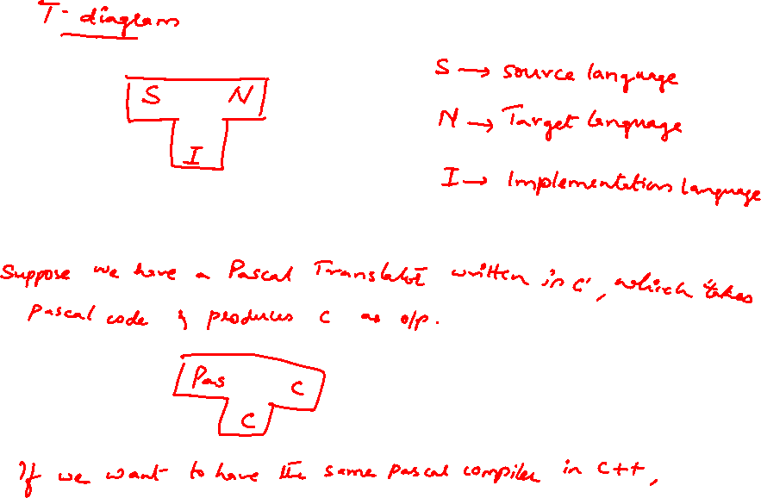

Slide 29
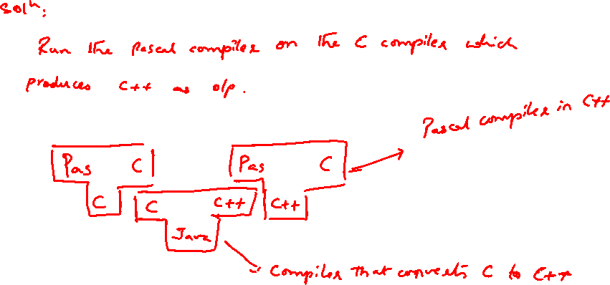

Slide 30
Advantages of Bootstrapping
It builds up a compiler for larger subsets of a language.
Suppose LNN is a compiler written for language L to generate
code for machine N.
Development takes place on machine M, where an existing compiler
LLM for L runs and generate code for M.
Step 1.
1st compile LLM with LNN
we obtain a cross compiler LNM that runs on N & produce code for M

Slide 31
Step 2.
Compile LNM for the 2nd time using generated cross compiler (LNM).
The result of 2nd compilation is a compiler LMM that runs
on N & generates code for M
The 2 steps can be combined as:

Slide 32
2. Using bootstrapping an optimizing compiler can optimize itself
Suppose all development is done on machine Q.
We have SsQ a good optimizing compiler for S written in S for machine Q.
We want SQQ a good optimizing compiler for S written in Q
We create SQ#Q#, a quick & dirty compiler for S on Q, that only generates poor code but also takes a long time to do so
However , we can use the compiler SQ#Q# to obtain a good compiler for S in 2 steps as:

